Slide 1
CASSANDRA
Presenter:
MARIA MIM(2101022)
MEHRIN FARZANA(2101013) KAMRUNNAHAR KEYA(2101025)
Date: 13/05/2024

Slide 2
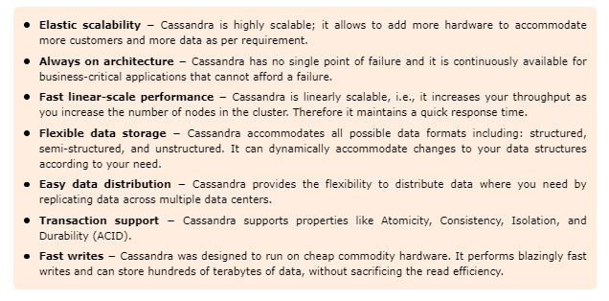
Cassandra
- a distributed NoSQL

Slide 3
commonly used –
In applications that require fast writes and reads at scale, such as messaging systems, time-series data, and recommendation engines.
Cassandra is being used by some of the biggest companies such as Facebook, Twitter, Cisco, Rackspace, ebay, Twitter, Netflix, and more.

Slide 4
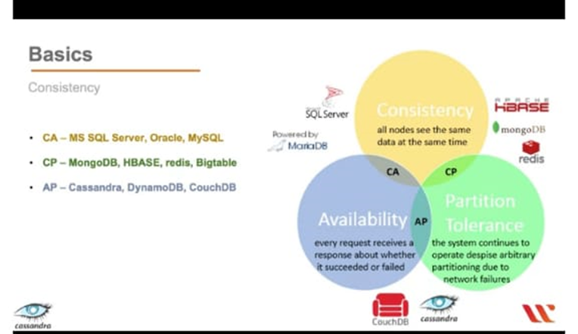
NoSQL data model
partitioned partitioned wide-column storage model with eventually consistent semantics.
wide-column storage model with eventually consistent semantics.

Slide 5
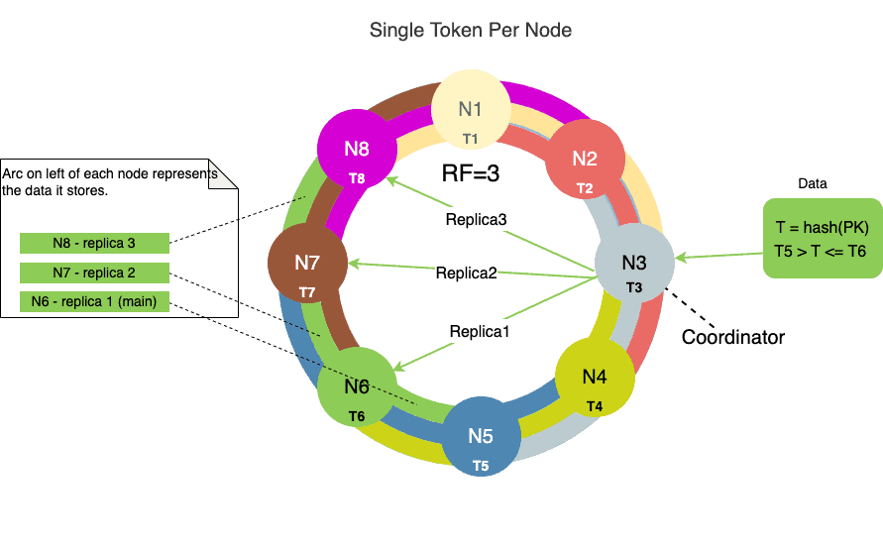
Cassandra’s Data Distribution:
Cassandra is a distributed database, meaning it spreads its data across multiple nodes in a cluster. This distribution is based on a consistent hashing algorithm (such as the Murmur3 hash function). Each data row is hashed, and the resulting hash value determines which node in the cluster will be responsible for storing that data. This distributed storage ensures that the workload is balanced across the cluster, preventing hotspots and bottlenecks.

Slide 6
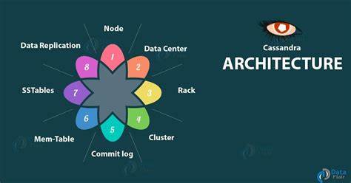
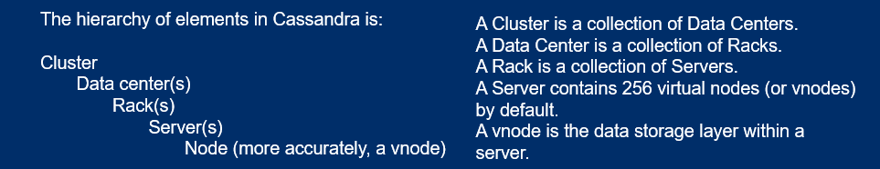
Architecture
NoSQL data model
partitioned partitioned wide-column storage model with eventually consistent semantics.
wide-column storage model with eventually consistent semantics.

Slide 7
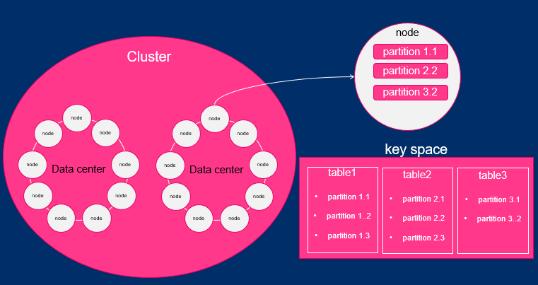

Slide 8
Nodes
Adding more nodes to a Cassandra cluster not only increases its storage capacity but also enhances its processing power and overall performance. Each additional node contributes to distributing the data and workload more evenly across the cluster, thereby improving the system's ability to handle concurrent requests and larger datasets. This scalability feature allows Cassandra to seamlessly accommodate growing demands without sacrificing performance or availability, making it a powerful solution for handling Big Data and high-throughput applications.
partitioned partitioned wide-column storage model with eventually consistent semantics.
wide-column storage model with eventually consistent semantics.

Slide 9
Data Model
Cassandra's data model is based on a distributed, partitioned, and replicated architecture, designed to handle large volumes of data across multiple nodes in a cluster efficiently.
Cluster
Cassandra database is distributed over several machines that operate together. The outermost container is known as the Cluster. For failure handling, every node contains a replica, and in case of a failure, the replica takes charge. Cassandra arranges the nodes in a cluster, in a ring format, and assigns data to them.

Slide 10
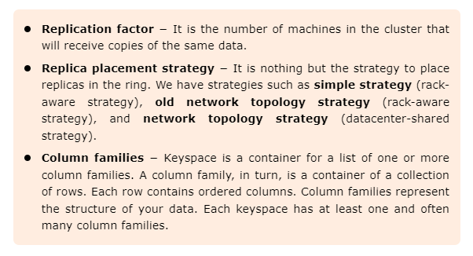
Keyspace –
Keyspace is the outermost container for data in Cassandra. The basic attributes of a Keyspace in Cassandra are −

Slide 11
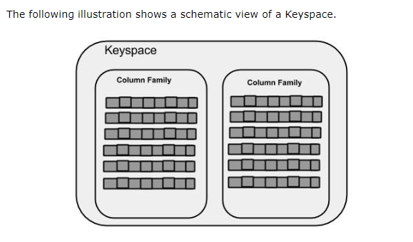
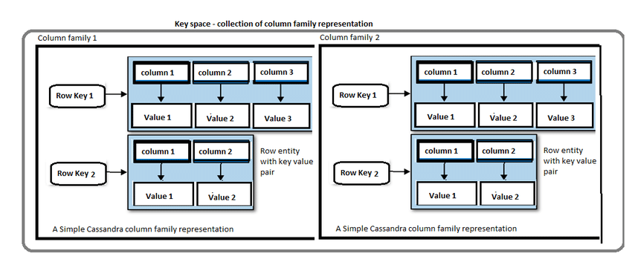

Slide 12
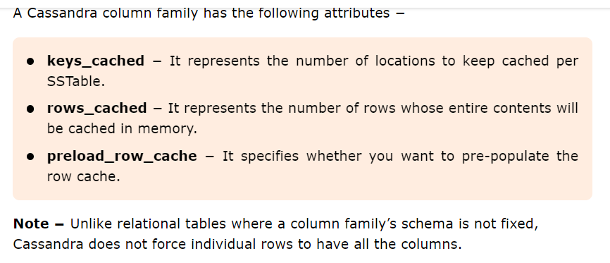
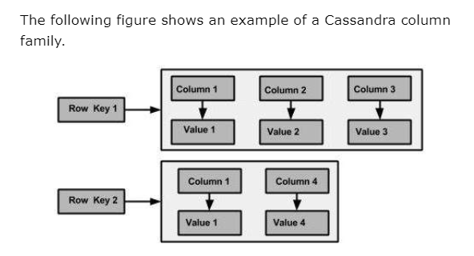

Slide 13
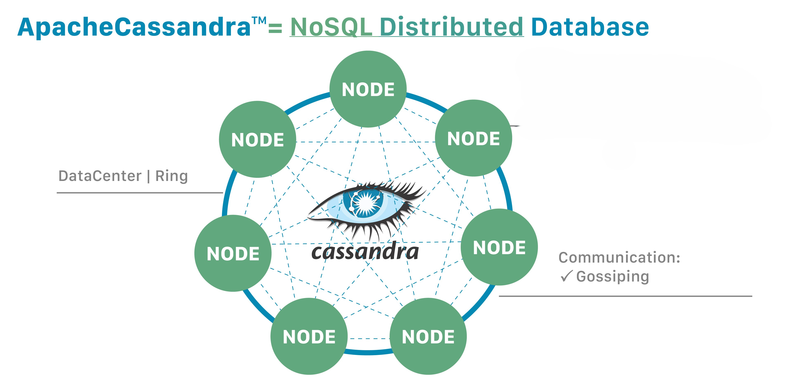

Slide 14
Architecture
03/04/2024
node
Cluster
partition 1.1
partition 2.2
partition 3.2
node
node
Data center
Data center
node
node
node
node
node
node
node
node
key space
table1
partition 1.1
partition 1..2
partition 1.3
table2
partition 2.1
partition 2.2
partition 2.3
table3
partition 3.1
partition 3..2
node
node
node
node
node
node
node
node

Slide 15
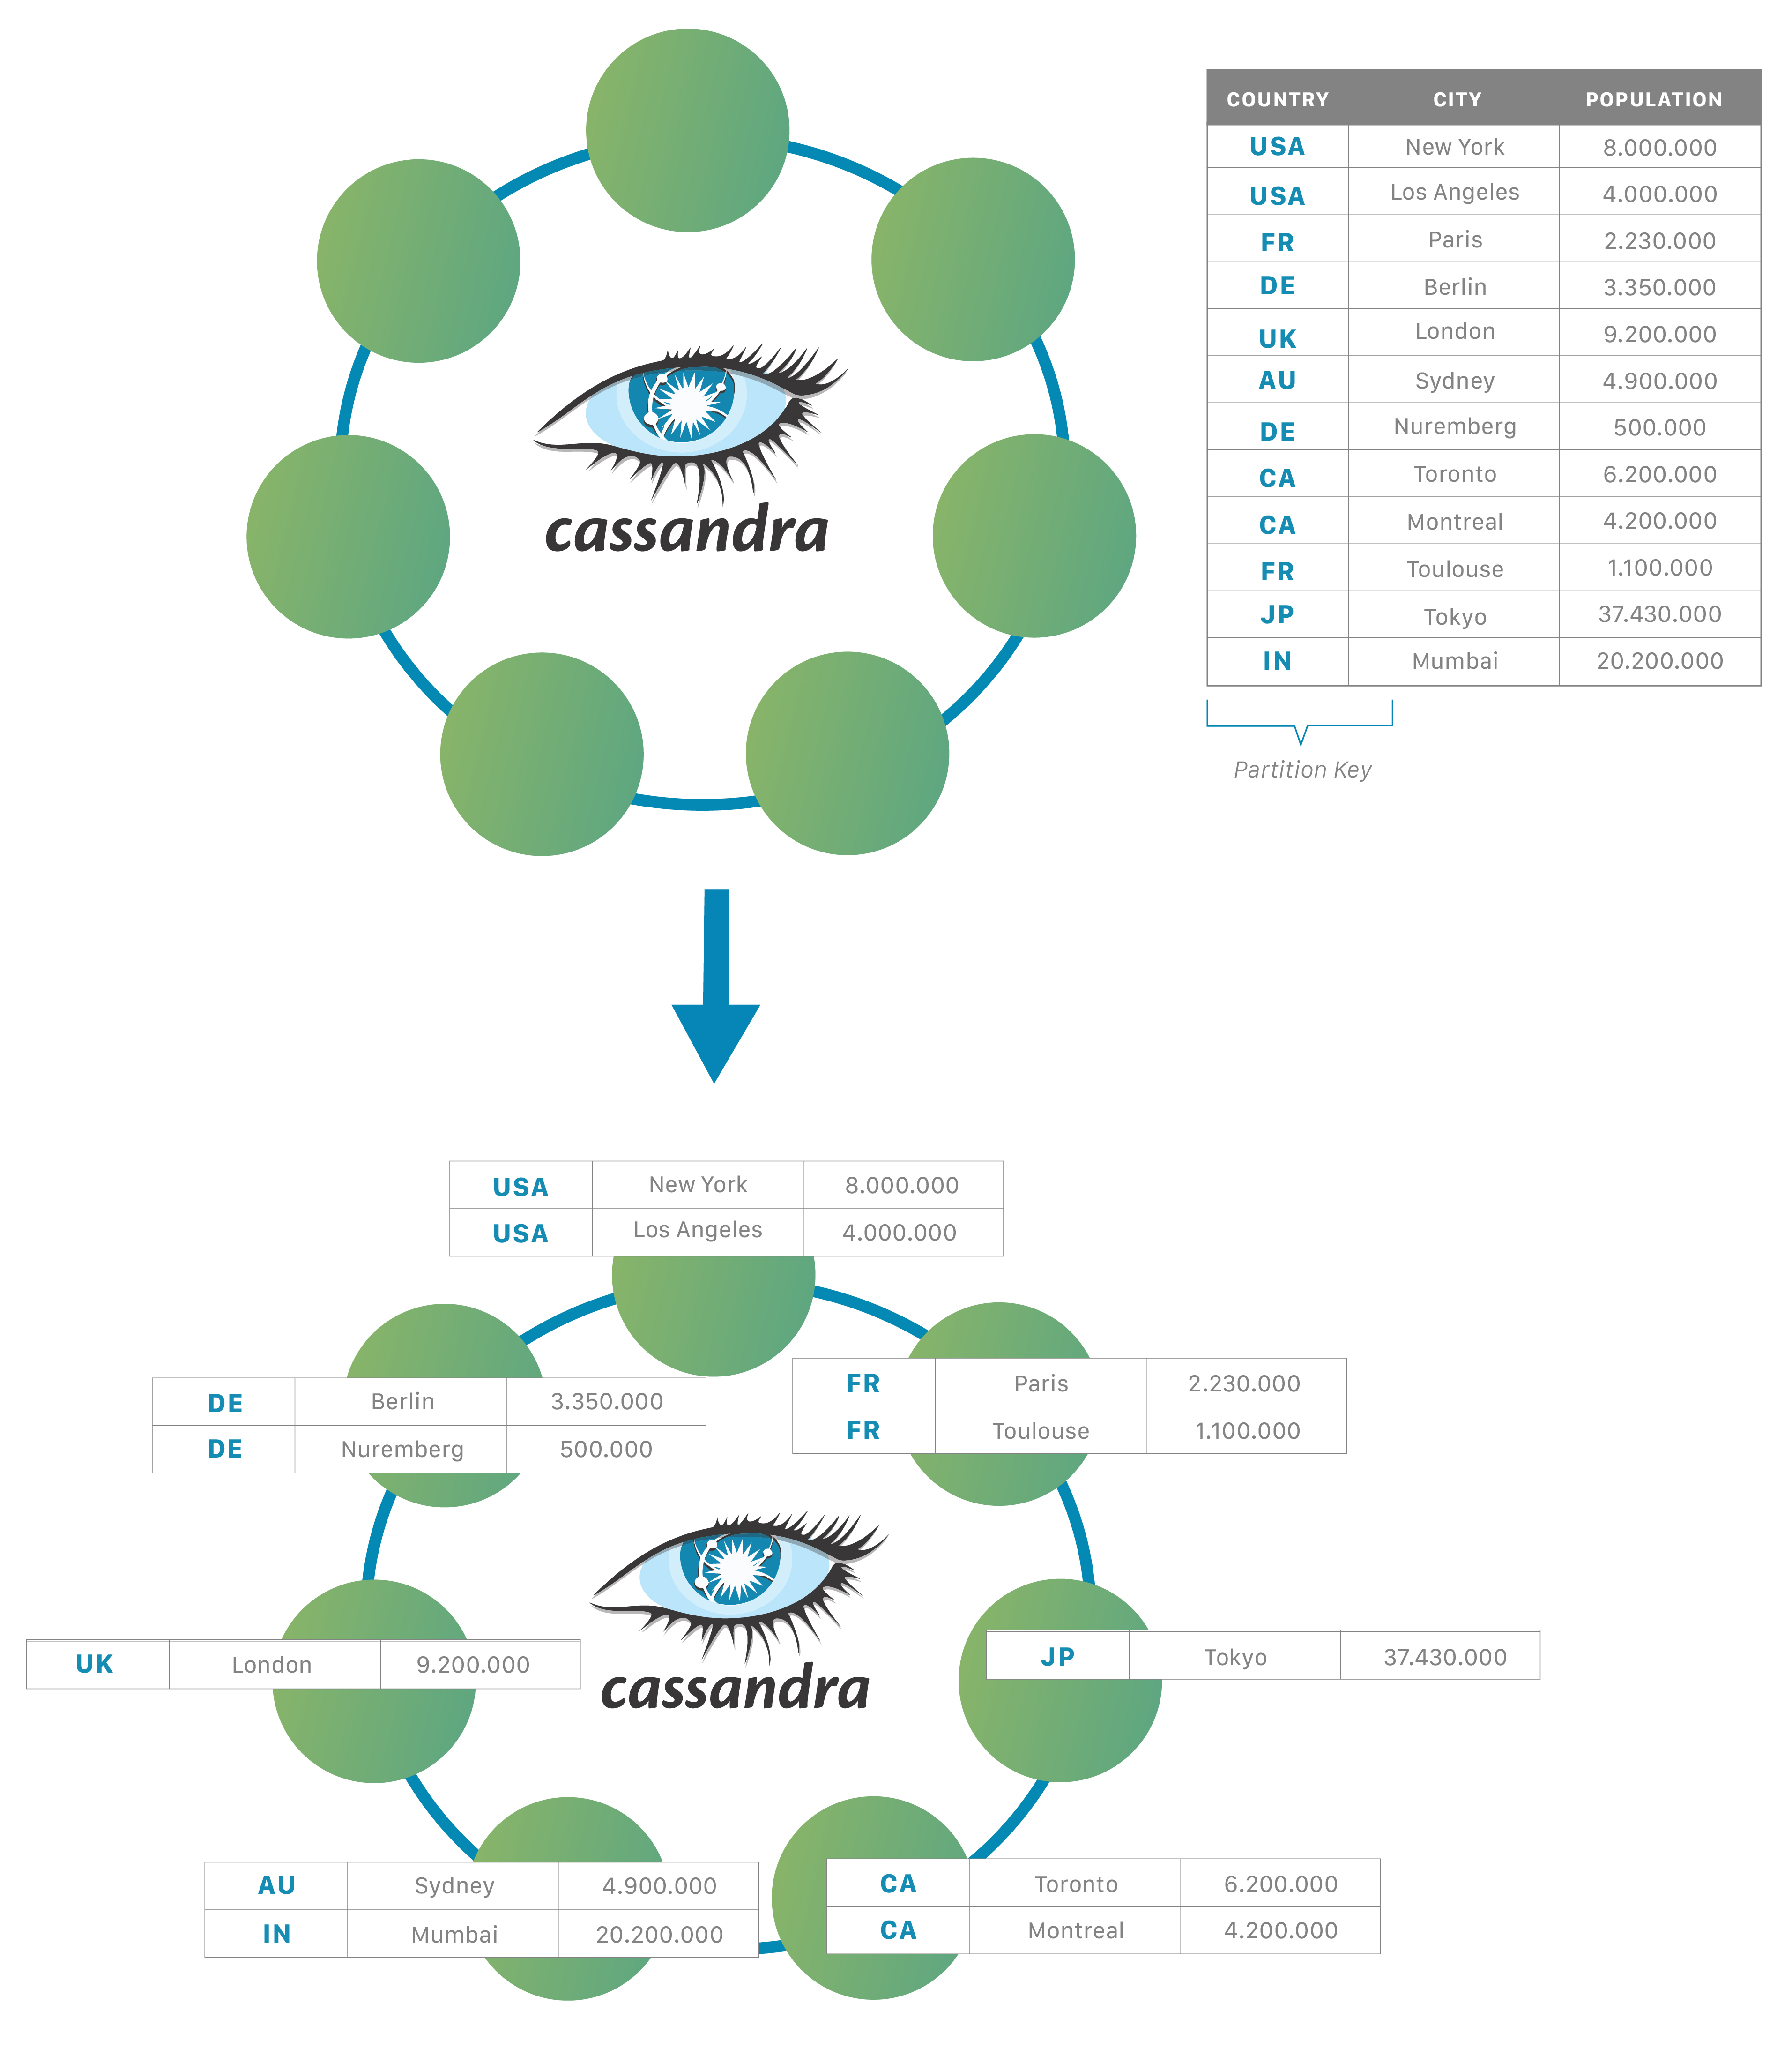

Slide 16
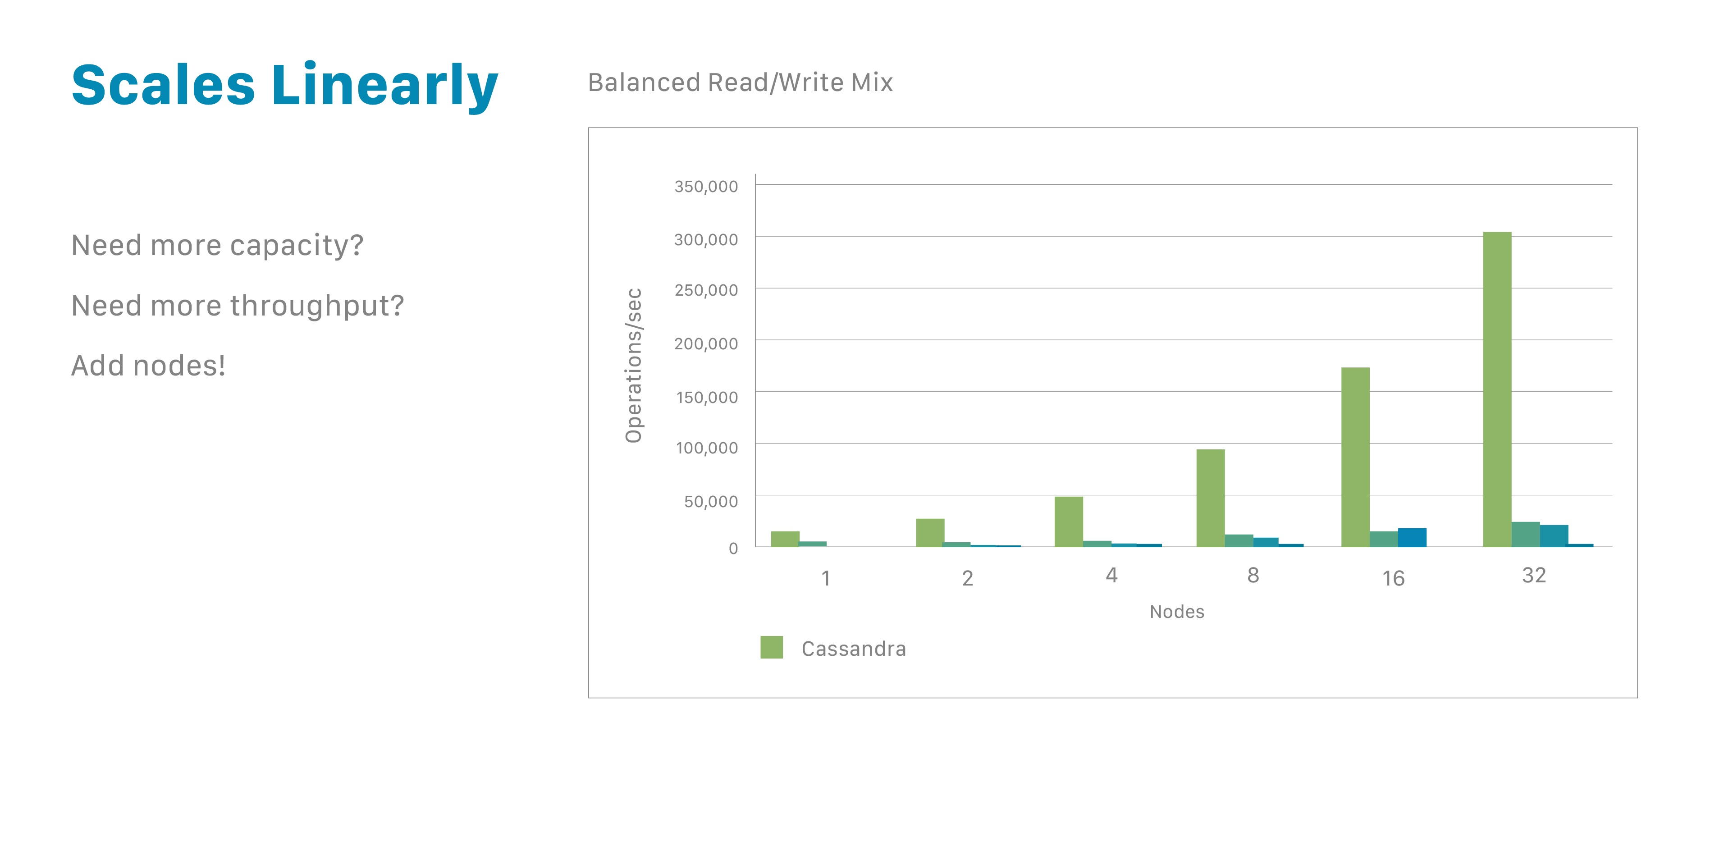

Slide 17
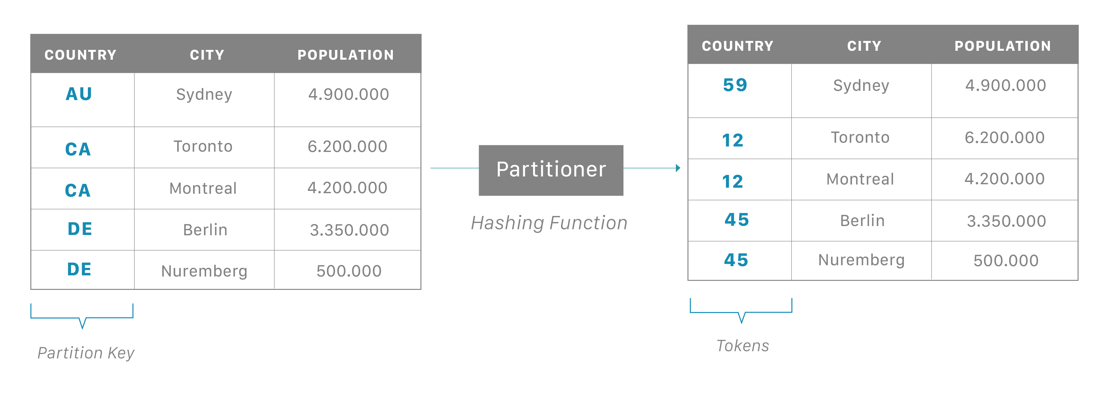

Slide 18
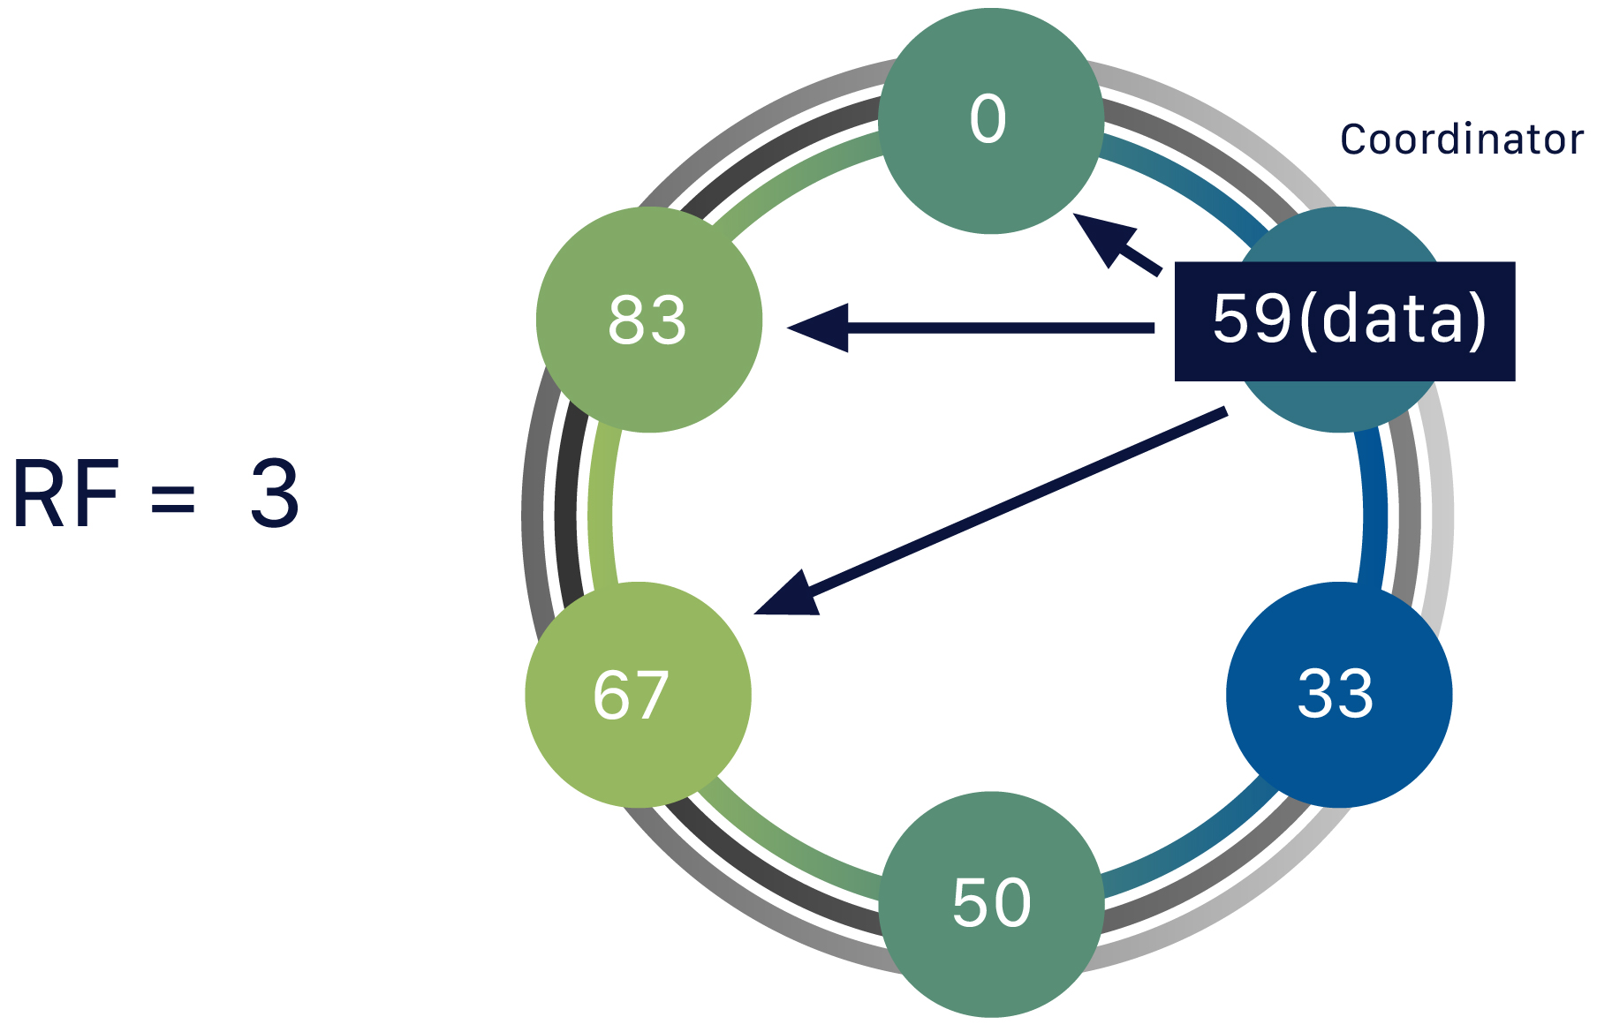
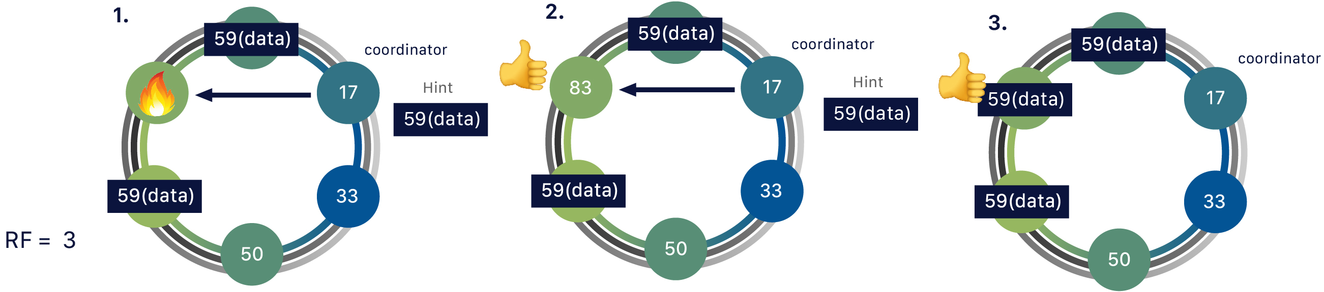

Slide 19
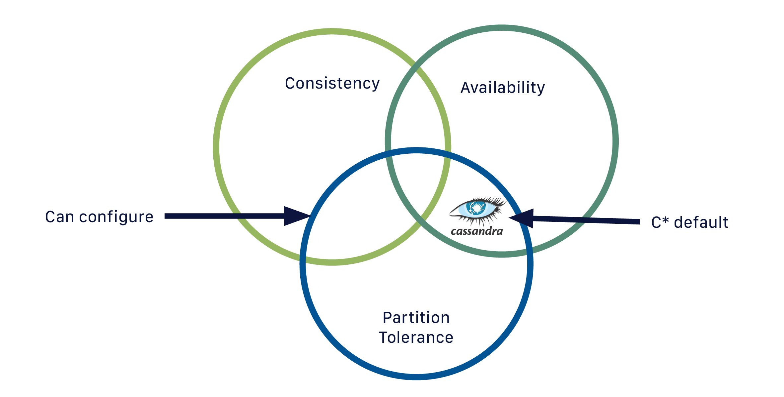

Slide 20
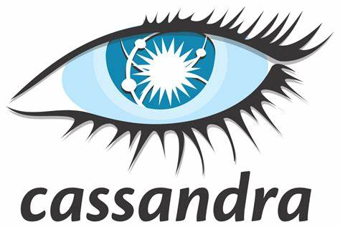
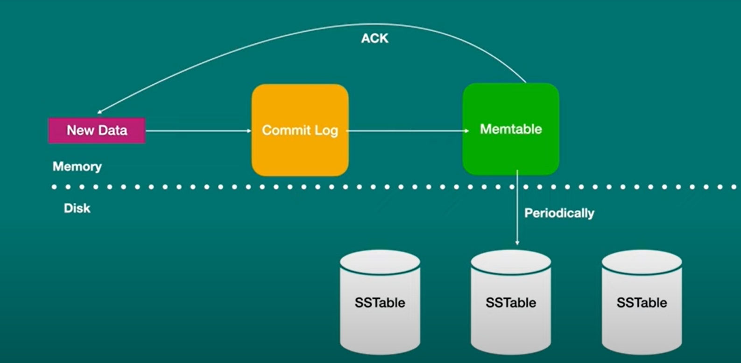
Fast Write
+ Parallel Writes and No Master Node Dependency

Slide 21
Cassandra processes data at several stages on the write path, starting with the immediate logging of a write and ending in with a write of data to disk:
Logging data in the commit log
Writing data to the memtable
Flushing data from the memtable
Storing data on disk in SSTables

Slide 22
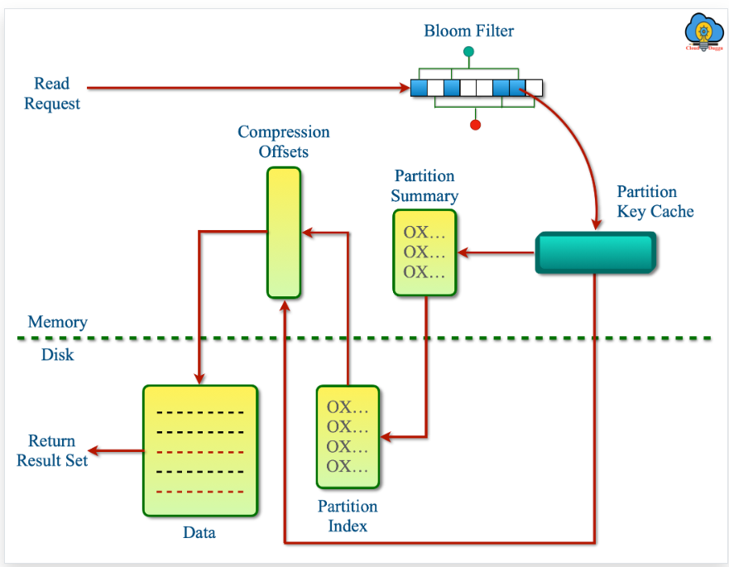
Fast Read

Slide 23
The following steps are followed to read the data from Cassandra.
The Read request will be made from the Client.
The request data will be checked in the memtable(RAM). If the requested data is present then data will be read from memtable(RAM) and merged with SSTables(DISK) files to send final data to the client.
If the row cache is enabled then it will be checked to find the data.
The Bloom Filters are loaded in the Heap memory that will be checked to find out the SSTables file that can store the requested partition data. Since Bloom Filters works on probabilistic function and can return false positives. In some cases Bloom Filters does not return the SSTable file then Cassandra further checks in the partition key cache.
The Partition Key Cache is used to store the partition index in heap memory and the partition index of data will be searched in that. If the Partition Key is present in the Partition Key Cache then Cassandra will go to compression offset to find the Disk that has the data. If the Partition Key is not present in the Partition Key Cache then the partition summary is searched to find user-requested data.

Slide 24
Partition Index is used to store the Partition key of the data that will be used in the Compression offset map to find out the exact location of the Disk which has stored the data.
The Compression offset map is used to hold the exact location of data. It uses the Partition key to locate that. Once the Compression offset map indicates the location where data is stored the further process is to fetch the data and share it with the user.

Slide 25
Cassandra Use Cases
Apache Cassandra is a widely used open-source NoSql database solution that was developed at Facebook. It is used by a wide range of organizations such as Netflix, Apple, Spotify, Twitter, Instagram, Rackspace, Cisco, and so on to perform different use cases. The Cassandra node setup is simple and the maintenance is automatically done. Cassandra takes care of the resynchronization and distribution of the data. The distributed decentralized architecture of Cassandra and the columnar storage facility provide a high speed of reading and writing operations on structured, semi-structured, and unstructured data.

Slide 26
Inventory management and E-commerce
The E-commerce companies are using Apache Cassandra to avoid site down issues and achieve a cost-effective scale because they can't afford the site down issue in peak hours. Cassandra's distributed and multi-region replication provides high availability of data and ensures zero downtime. The peer-to-peer architecture put data in the resign around the world and closed to the customer due to which the response of query is very fast.

Slide 27
(IoT)Internet of things and edge computing
The IoT devices are producing never-ending data such as weather tracking, traffic detail, health indicators, sensors data, vehicles, mobile device data, and so on. Apache Cassandra is capable of ingesting the concurrent data from any node with him and capable to handle any high-velocity data.
Below are some of the reasons in which Apache Cassandra is fit for the (IoT)Internet of things and edge computing devices.
All nodes in Apache Cassandra can perform read and write operations and can ingest data concurrently.
Apache Cassandra is capable of handling high volume and time-series data.
Apache Cassandra supports real-time analysis and high availability.

Slide 28
Authentication and Fraud Detection
Security threats are always a concern in organizations and companies are using the smart fraud detection mechanism to catch those frauds because hackers are trying different ways to hack sensitive customer data.
The following are some of the reasons to use Apache Cassandra in Fraud detection and authentication.
Apache Cassandra provides the flexible schema and data type to handle a variety of data.
Apache Cassandra supports complex analysis and incorporates AI(artificial intelligence) and Machine learning algorithms.

Slide 29
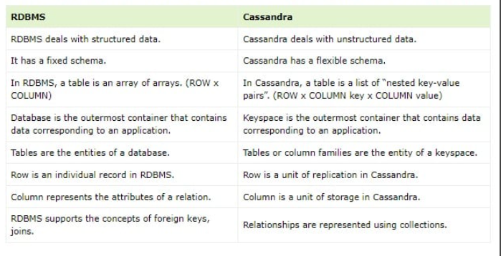
Difference Between RDBMS and Cassandra

